Slide 1
3D Vision
How do we obtain 3D image data?
What can we do with it?

Slide 2
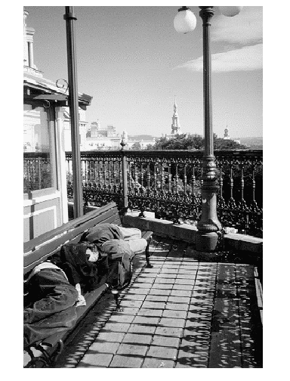
What can you determine about
1. the sizes of objects
2. the distances of objects from the camera?
What knowledge
do you use to
analyze this image?

Slide 3
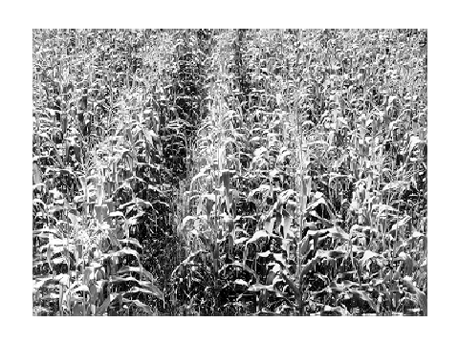
What objects are shown in this image?
How can you estimate distance from the camera?
What feature changes with distance?

Slide 4
3D Shape from X
shading
silhouette
texture
stereo
light striping
motion
mainly research
used in practice

Slide 5
Perspective Imaging Model: 1D
real image
point
This is the axis of the
real image plane.
E
xi
f
camera lens
O is the center of projection.
O
image of point
B in front image
D
This is the axis of the front
image plane, which we use.
zc
xf
xi xc
f zc
=
xc
B
3D object
point

Slide 6
Perspective in 2D
(Simplified)
Yc
camera
P´=(xi,yi,f)
Xc
3D object point
yi
P=(xc,yc,zc)
=(xw,yw,zw)
ray
f
F
xi
yc
optical
axis
zw=zc
xi xc
f zc
=
xi = (f/zc)xc
yi = (f/zc)yc
Zc
xc
Here camera coordinates
equal world coordinates.
yi yc
f zc
=

Slide 7
3D from Stereo
3D point
left image
right image
disparity: the difference in image location of the same 3D
point when projected under perspective to two different cameras.
d = xleft - xright

Slide 8
Depth Perception from Stereo
Simple Model: Parallel Optic Axes
image plane
z
Z
camera
L
f
xl
baseline
b
f
camera
R
xr
x-b
X
P=(x,z)
z x
f xl
z x-b
f xr
z y y
f yl yr
y-axis is
perpendicular
to the page.
=
=
=
=

Slide 9
Resultant Depth Calculation
For stereo cameras with parallel optical axes, focal length f,
baseline b, corresponding image points (xl,yl) and (xr,yr)
with disparity d:
z = f*b / (xl - xr) = f*b/d
x = xl*z/f or b + xr*z/f
y = yl*z/f or yr*z/f
This method of
determining depth
from disparity is
called triangulation.

Slide 10
Finding Correspondences
If the correspondence is correct,
triangulation works VERY well.
But correspondence finding is not perfectly solved.
for the general stereo problem.
For some very specific applications, it can be solved
for those specific kind of images, e.g. windshield of
a car.
°
°

Slide 11
3 Main Matching Methods
1. Cross correlation using small windows.
2. Symbolic feature matching, usually using segments/corners.
3. Use the newer interest operators, ie. SIFT.
dense
sparse
sparse

Slide 12
Epipolar Geometry Constraint:
1. Normal Pair of Images
The epipolar plane cuts through the image plane(s)
forming 2 epipolar lines.
P
y1
z1
z2
y2
epipolar
plane
P1
x
P2
C1
b
C2
The match for P1 (or P2) in the other image,
must lie on the same epipolar line.

Slide 13
Epipolar Geometry:
General Case
P
y1
y2
P2
x2
P1
e2
e1
x1
C1
C2

Slide 14
Constraints
1. Epipolar Constraint:
Matching points lie on
corresponding epipolar
lines.
2. Ordering Constraint:
Usually in the same
order across the lines.
P
Q
e2
e1
C1
C2

Slide 15
Structured Light
light stripe
3D data can also be derived using
a single camera
a light source that can produce
stripe(s) on the 3D object
light
source
camera

Slide 16
Structured Light
3D Computation
3D data can also be derived using
a single camera
a light source that can produce
stripe(s) on the 3D object
3D point
(x, y, z)
θ
(0,0,0)
light
source
b
x axis
f
b
[x y z] = --------------- [x´ y´ f]
f cot θ - x´
(x´,y´,f)
3D
image

Slide 17
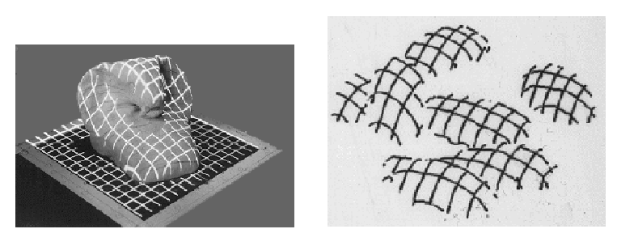
Depth from Multiple Light Stripes
What are these objects?

Slide 18
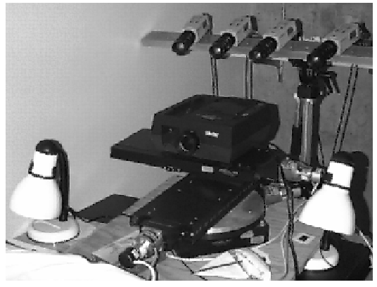
4-camera light-striping stereo
cameras
projector
rotation
table
3D
object

Slide 19
Camera Model: Recall there are 5 Different Frames of Reference
yc
Object
World
Camera
Real Image
Pixel Image
xc
C
yf
zw
xf
image
a
W
zc
yw
pyramid
object
zp
A
yp
xp
xw

Slide 20
Rigid Body Transformations in 3D
zp
pyramid model
in its own
model space
zw
xp
yp
W
rotate
translate
scale
yw
instance of the
object in the
world
xw

Slide 21
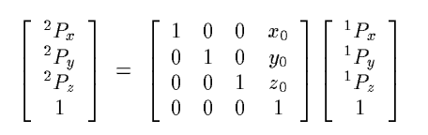
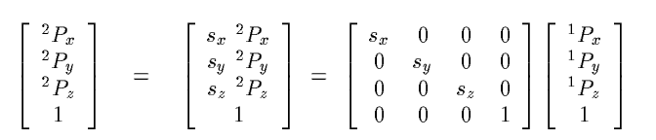
Translation and Scaling in 3D

Slide 22
Rotation in 3D is about an axis
z
rotation by angle θ
about the x axis
θ
y
x
Px´
Py´
Pz´
1
1 0 0 0
0 cos θ - sin θ 0
0 sin θ cos θ 0
0 0 0 1
Px
Py
Pz
1
=

Slide 23
Rotation about Arbitrary Axis
T
R1
R2
One translation and two rotations to line it up with a
major axis. Now rotate it about that axis. Then apply
the reverse transformations (R2, R1, T) to move it back.
Px´
Py´
Pz´
1
r11 r12 r13 tx
r21 r22 r23 ty
r31 r32 r33 tz
0 0 0 1
Px
Py
Pz
1
=

Slide 24
The Camera Model
How do we get an image point IP from a world point P?
Px
Py
Pz
1
s Ipr
s Ipc
s
c11 c12 c13 c14
c21 c22 c23 c24
c31 c32 c33 1
=
image
point
camera matrix C
world
point
What’s in C?

Slide 25
The camera model handles: the rigid body transformation from world coordinates to camera coordinates plus (+) the perspective transformation to image coordinates.
1. CP = T R WP
2. IP = π(f) CP
CPx
CPy
CPz
1
s Ipx
s Ipy
s
1 0 0 0
0 1 0 0
0 0 1/f 1
=
image
point
perspective
transformation
3D point in
camera
coordinates

Slide 26
Camera Calibration
In order work in 3D, we need to know the parameters
of the particular camera setup.
Solving for the camera parameters is called calibration.
yc
Intrinsic parameters are
of the camera device
Extrinsic parameters are
where the camera sits
in the world
yw
C
xc
zc
W
xw
zw

Slide 27
Intrinsic Parameters
principal point (u0,v0)
scale factors (dx,dy)
aspect ratio distortion factor γ
focal length f
lens distortion factor κ
(models radial lens distortion)
C
f
(u0,v0)

Slide 28
Extrinsic Parameters
Translation parameters
t = [tx ty tz]
Rotation matrix
r11 r12 r13 0
r21 r22 r23 0
r31 r32 r33 0
0 0 0 1
R =
Are there really
nine parameters?

Slide 29
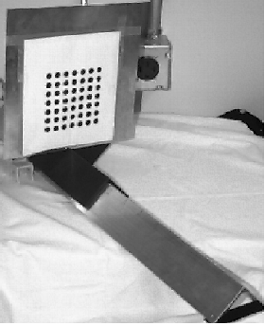
Calibration Object
The idea is to snap
images at different
depths and get a
lot of 2D-3D point
correspondences.

Slide 30
The Tsai Procedure
The Tsai procedure was developed by Roger Tsai
at IBM Research and is most widely used.
Several images are taken of the calibration object
yielding point correspondences at different distances.
Tsai’s algorithm requires n > 5 correspondences
{(xi, yi, zi), (ui, vi)) | i = 1,…,n}
between (real) image points and 3D points.

Slide 31
Tsai’s Geometric Setup
camera
Oc
y
x
image plane
principal point p0
pi = (ui,vi)
(0,0,zi)
y
Pi = (xi,yi,zi)
x
3D point
z

Slide 32
Tsai’s Procedure
Given n point correspondences ((xi,yi,zi), (ui,vi))
Estimates
  9 rotation matrix values
  3 translation matrix values
  focal length
  lens distortion factor
By solving several systems of equations

Slide 33
We use them for general stereo.
P
y1
y2
P2=(r2,c2)
x2
P1=(r1,c1)
e2
e1
x1
C1
C2

Slide 34
For a correspondence (r1,c1) in image 1 to (r2,c2) in image 2:
c11 c12 c13 c14
c21 c22 c23 c24
c31 c32 c33 1
x
y
z
world
point
camera matrix C
1. Both cameras were calibrated. Both camera matrices are
then known. From the two camera equations we get
4 linear equations in 3 unknowns.
r1 = (b11 - b31*r1)x + (b12 - b32*r1)y + (b13-b33*r1)z
c1 = (b21 - b31*c1)x + (b22 - b32*c1)y + (b23-b33*c1)z
r2 = (c11 - c31*r2)x + (c12 - c32*r2)y + (c13 - c33*r2)z
c2 = (c21 - c31*c2)x + (c22 - c32*c2)y + (c23 - c33*c2)z
Direct solution uses 3 equations, won’t give reliable results.

Slide 35
Solve by computing the closest approach of the two skew rays.
P1
solve for
shortest
If the rays
intersected
perfectly in 3D,
the intersection
would be P.
V
P
Q1
Instead, we solve for the shortest line
segment connecting the two rays and
let P be its midpoint.

Slide 36
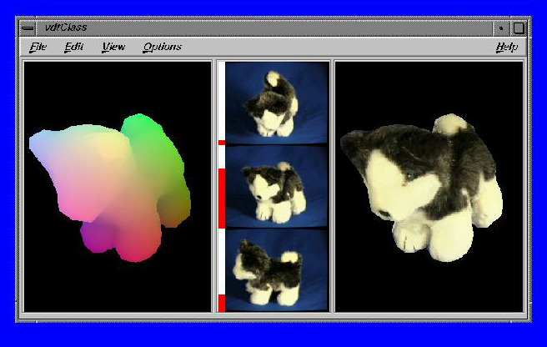
Application: Kari Pulli’s Reconstruction of 3D Objects from light-striping stereo.

Slide 37
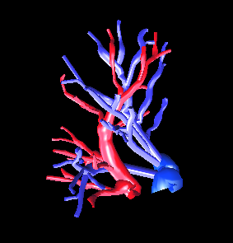
Application: Zhenrong Qian’s 3D Blood Vessel Reconstruction from Visible Human Data

Slide 38
Stereo
Advantages:
  Cheap hardware (2 cameras)
  Easy to accommodate motion
  Intuitive analogue to human vision
Disadvantages:
  Only acquire good data at “features”
  Sparse, relatively noisy data (correspondence is hard)
  Bad around silhouettes
  Confused by non-diffuse surfaces
Variant: multibaseline stereo to reduce ambiguity

